Slide 1
Motivation……?

Slide 2
Exploring community detection in various Areas of research
Team:
2021AIM1011 - M Pavan Naik
2021CSM1014 - Srinivas P

Slide 3
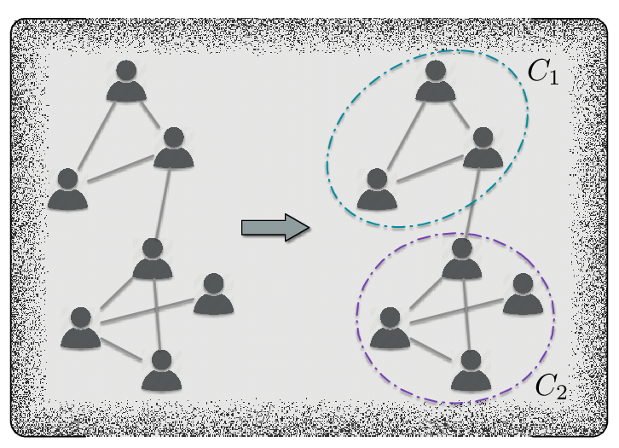
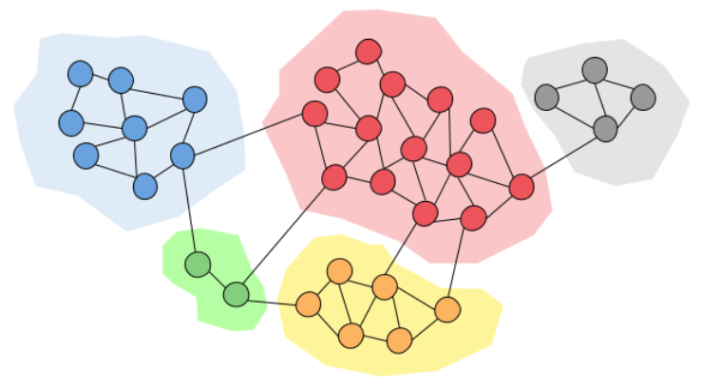
What is Community detection? & Why is community detection?

Slide 4
Algorithm used for community detection(Girvan-Newman)
What is Girvan Newman technique?
Pseudocode:
REPEAT
LET n BE number of edges in the graph
FOR i=0 to n-1
LET B[i] BE betweenness centrality of edge i
IF B[i] > max_B THEN
max_B = B[i]
max_B_edge = i
ENDIF
ENDFOR
remove edge i from graph
UNTIL number of edges in graph is 0

Slide 5
CODE Explanation

Slide 6
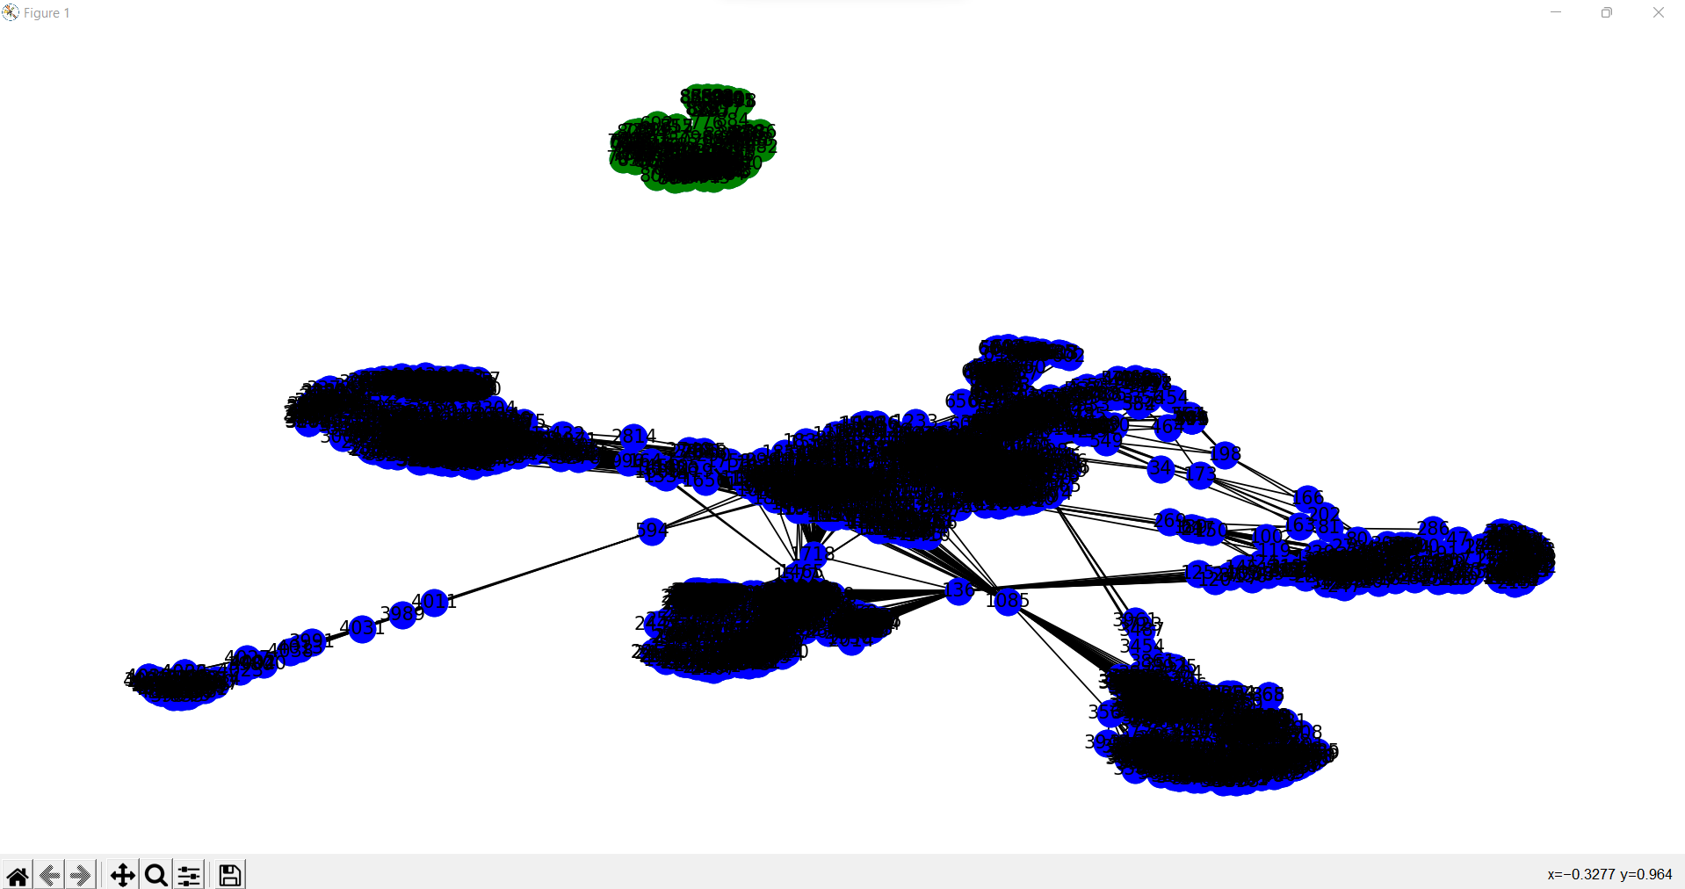
Output

Slide 7
Use cases of community detection
Plagiarism check
Criminology
Recommendation Systems
Smart advertising & Targeted marketing

Slide 8



Plagiarism check
Instructor
Community
Students
Community Detection
……….....

Slide 9
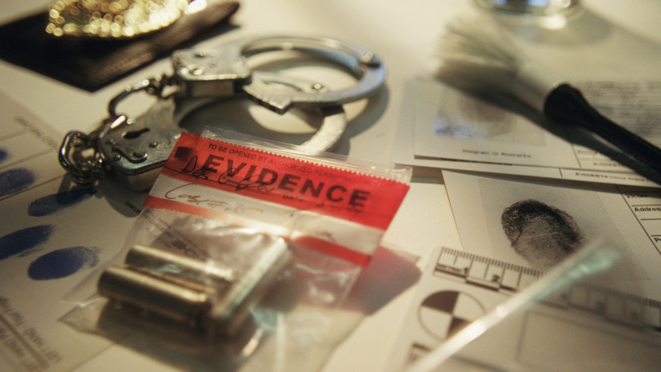
Criminology
Centrality Measures
Degree Centrality
Betweenness Centrality
Closeness Centrality
Eigenvector centrality
Page Rank

Slide 10
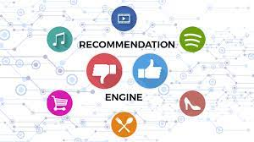
Recommendation Systems
Preferences of user friend.
“Tell me who your friends are, and I will tell you who you are.”

Slide 11

Smart advertising & Targeted marketing
Targets webpage visitors
Predict interests of community

Slide 12
There are many such applications(static and dynamic) as mentioned below:
Application Area | Sub-Area | CD method
Criminology | Criminal Identification | Static
 | Fraud Detection | Static
 | Criminal Activities Detection | Static
 | Bot Detection | Static
Public Health | Dynamics of Epidemic spreading | Dynamic
 | Cancer/Tumor Detection | Static
 | Tissue/Organ Detection | Static
Politics | Evolution of Influence | Dynamic
 | Astroturfing | Static
Smart Advertising | Customer Segmentation | Static
Targeted Marketing | Customer Segmentation | Static
Recommendation Systems | Customer Segmentation | Static
Social Network Analysis | Community Detection | Both
Network Summarization | Member Grouping | Static
Privacy | Group Segmentation | Static
Link Prediction | Link Prediction | Both
Community Evolution Prediction | Community Evolution | Dynamic
Application areas, sub-areas, and nature of correspondent community detection method

Slide 13
Conclusion
Wide range of application domains in community detection.
Instability problem.

Slide 14
Future work
Applied to smart cities or any other emerging fields
Can never be underestimated
Solving instability gives reliability

Slide 15
Thank you

